Slide 1
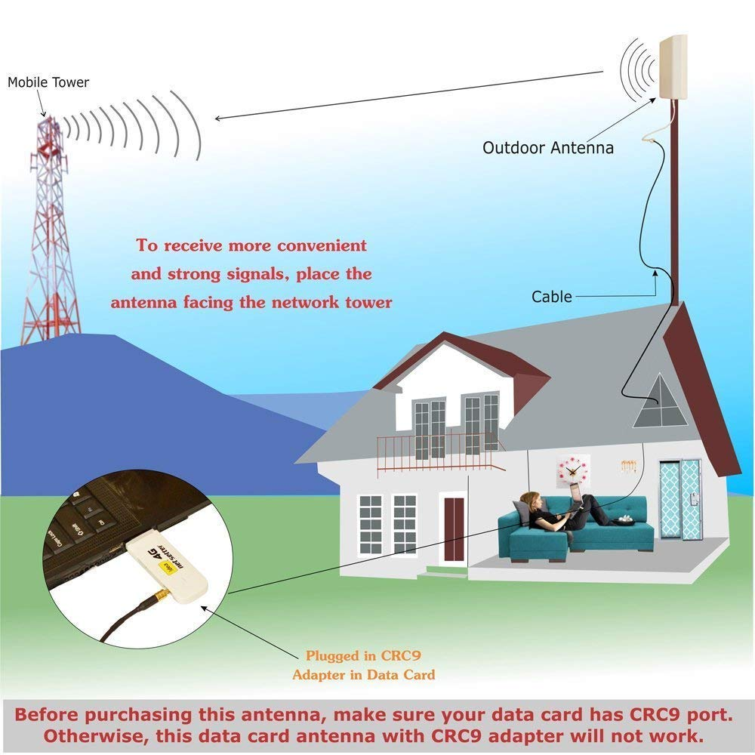

Slide 2
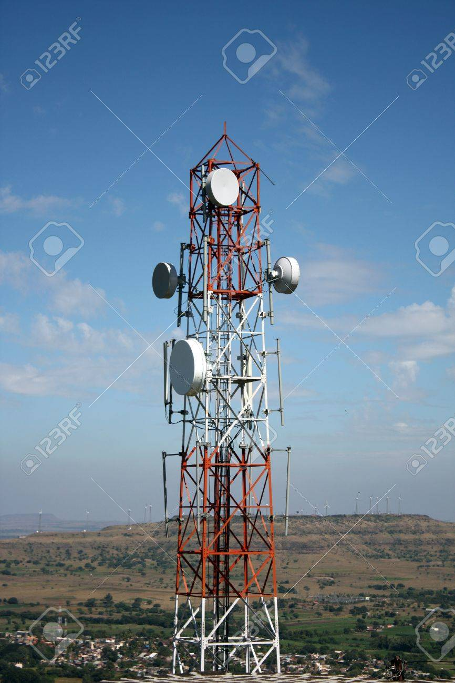

Slide 3
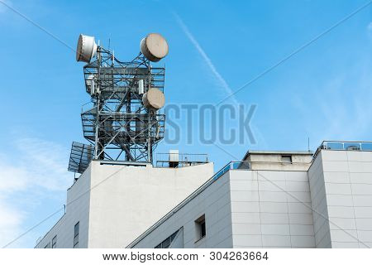

Slide 4
UNIT - IV
VHF, UHF and Microwave Antennas - II: Microstrip Antennas – Introduction, Features, Advantages and Limitations, Rectangular Patch Antennas – Geometry and Parameters, Characteristics of Microstrip Antennas. Reflector Antennas – Introduction, Flat Sheet and Corner Reflectors, Paraboloidal Reflectors – Geometry, Pattern Characteristics, Feed Methods, Reflector Types – Related Features.

Slide 5
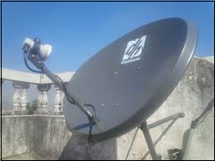
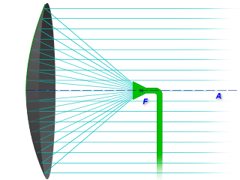

Slide 6
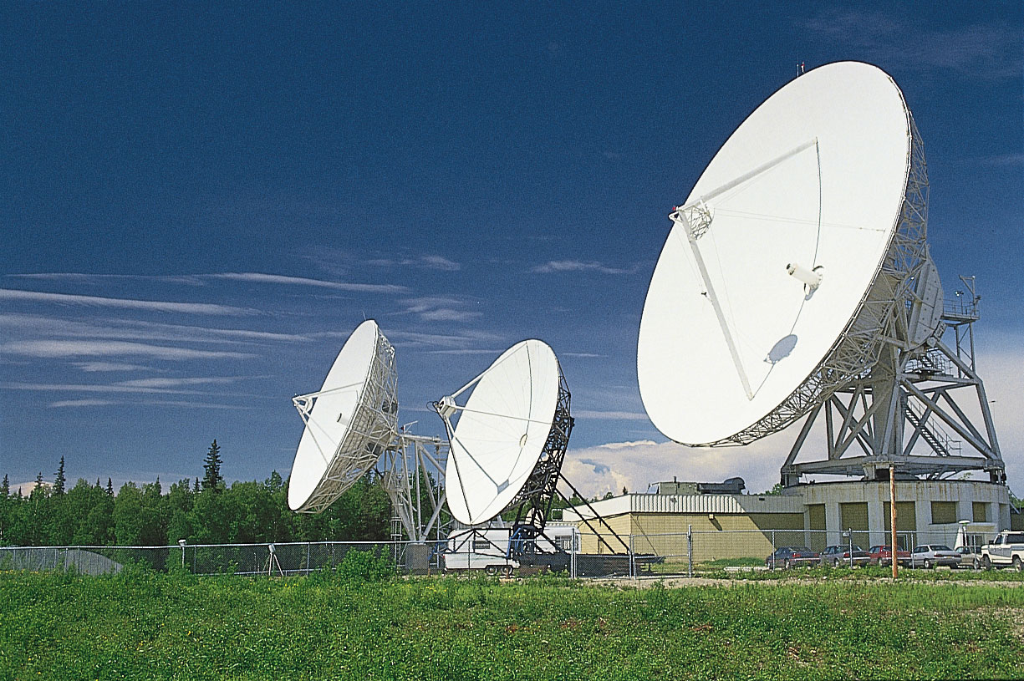

Slide 7
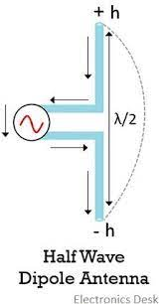

Slide 8
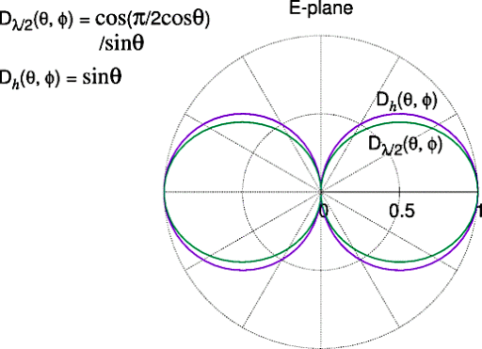

Slide 9
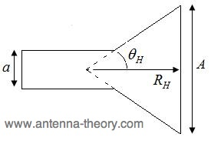
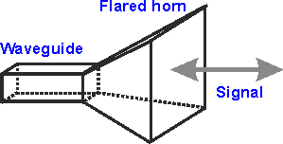

Slide 10
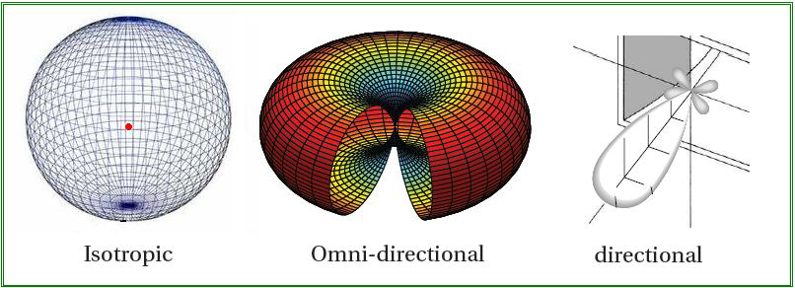

Slide 11
Reflector Antennas
Antennas that are designed to reflect the incident electromagnetic waves originating from a separate source are known as reflector antennas. It is designed to operate at high microwave frequency.
These antennas belong to the category that offers high directionality while radiating.

Slide 12
Content: Reflector Antennas
Introduction
Operating Principle
Types of Reflector
Applications

Slide 13
Introduction
Reflector antennas hold great importance when we deal with signals operating in microwave frequency ranges. Initially, it is in use since the time electromagnetic wave propagation came into existence.
Hertz proposed the idea of electromagnetic wave propagation in the year 1888.
However, these antennas gained their major presence in radar systems at the time of World War II.

Slide 14
Operating Principle of Reflector Antennas
` We are already aware of the fact that this operates at a high range of microwave frequencies. Also, at this frequency, the electromagnetic wave behaves as a light wave. Hence, it gets reflected when strikes a polished surface.
This is the principle of operation of a reflector antenna.
However, a crucial point over here is that a reflector antenna is a combination of feed element and a reflecting surface.
This means in case of reflector antenna a reflecting surface along with an antenna element is required in order to provide excitation to the reflecting element. This means that it is composed of an active and a passive element.
The antenna that is used to provide excitation is known as the active element. While the one that re-radiates the energy emitted by the active element is the passive element which is nothing but the reflecting surface.

Slide 15
So, simply we can infer that the feed is the active element while the reflector is the passive element.
Generally, dipole, horn or slot antennas are used as the active elements for providing excitation to the reflector antenna. Sometimes the active element is also known as the primary antenna whereas the passive element is called the secondary antenna.
Reflector antenna plays a very crucial role in radio wave propagation as it modifies the radiation pattern of the radiating elements.
It operates in a way that energy from the feed is directed towards the reflecting surface placed at an appropriate position. The reflector on gaining the energy further guides it in a particular direction.
The radiation pattern of the feed is referred as a primary pattern but that originating from the reflector is referred as a secondary pattern.

Slide 16
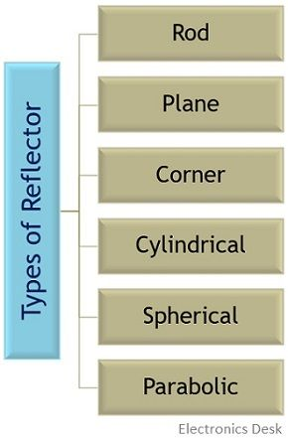
Types of Reflectors
Depending on the geometrical shape possessed by the reflecting surface, the reflector antennas are classified into the following categories:

Slide 17
Plane Reflector:
It is also referred as flat sheet reflector and is regarded as one of the simplest reflectors that direct the electromagnetic wave in the appropriate direction.
It is nothing but a plane metallic sheet that is located at a certain distance from the feed. For the incoming radio waves, it acts as a plane mirror and allows them to undergo reflection through it.

Slide 18
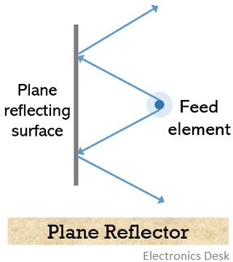

Slide 19
It is to be noted that a plane reflector possesses difficulty in collimating the overall energy in the forward direction.
Thus, to handle the impedance, pattern characteristics, gain and directivity of the system, the polarization of the active element along with its position in reference to the reflecting surface is used.

Slide 20
Corner Reflector:
It is regarded as a modified version of the plane reflector so as to guide most of the radiation in the forward direction. Basically, the shape of a plane reflector is changed by joining two flat sheets in order to form a corner. There can also be three mutually perpendicular conducting plane surfaces.

Slide 21
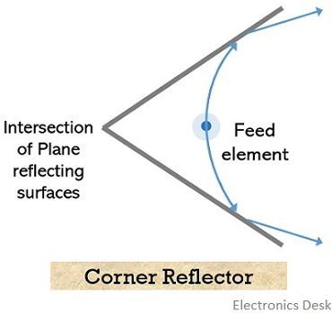

Slide 22
Parabolic Reflector
A type of reflector which has a reflecting surface having the shape of a paraboloid that is used to collect and re-radiated the electromagnetic energy is known as Parabolic Reflector.
It is regarded as the simplest and popular form of reflector antenna.
These are known as microwave antennas as exhibit a wide range of use at microwave frequencies in terms of communication.

Slide 23
Content: Parabolic Reflector
Introduction
Parabola
Working Principle
Design Consideration
Radiation Pattern
Advantages
Disadvantages
Applications

Slide 24
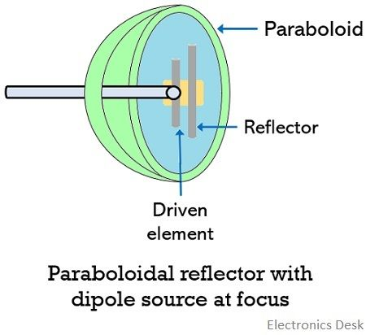
Introduction
We have already discussed in our previous article of reflector antenna that energy from the feed element when strikes the polished surface then it is re-radiated in a particular direction.
The parabolic reflector is sometimes referred as a dish antenna and its distinctive shape offers high gain and narrow bandwidth.
It is regarded as a reflective device that is used both at transmitting as well as receiving antenna.

Slide 25
What is a parabola?
A parabola is regarded as a two-dimensional plane curve. While a reflector antenna must possess a three-dimensional structure
.
Thus, to form a parabolic reflector, a parabola is rotated about its axis. After rotating the parabola about its axis, a paraboloid is generated. This paraboloid acts as a parabolic reflector.
The feed is located at point F, which is referred as the focus.
As the opening of the paraboloid is circular therefore, it produces a beam of the circular cross-section.

Slide 26
Working Principle of Parabolic Reflector
Consider having a parabolic reflector in receiving mode and where the feed element is present at the focus. The crucial function of the parabolic reflector is to change the spherical wave into a plane wave.
So, at the focus when a feed antenna is placed which is nothing but an isotropic source then the waves are emitted from the source.
The radiating element used at the focus is generally dipole or horn antenna, which are used to illuminate the reflecting surface.
Thus, the waves emitted from the source, incident on the surface of the reflector and are further reflected back as a plane wave of circular cross-section. This is represented below:

Slide 27
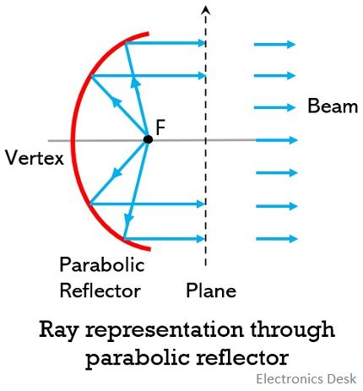

Slide 28
As we can see clearly in the above figure that the waves from the feed incidents at different points on the parabolic surface. However, all the waves after reflection are collimated and the plane waves travel in the direction parallel to the axis.
It is to be noted here that, if there is any deviation of the surface of the reflector from an actual paraboloid then it must not be more than some fraction of wavelength.
Thus, all the collimated waves from the reflecting surface have equal path length i.e., twice the focal length with a similar phase.
This will lead to provide very high radiation in the direction of the parabolic axis. In this way, the spherical wave from the feed is converted into a plane wave.

Slide 29
Design Consideration
We have already discussed that reflector helps to eliminate the direct radiation from the source. But while designing a parabolic reflector the point of focus where the feed is present is to be decided carefully.
This is so because if:
The focus is present inside the aperture i.e., the focal length is very small then it will be difficult to provide adequate uniform aperture to the source.
The focal length is quite large i.e., the focus is far beyond the aperture, then it will cause difficulty in focusing the radiation from source to the surface.

Slide 30
For the focal point in the plane of aperture, the focal length offered by the geometry of parabola is one-fourth of the diameter of the aperture.
A noteworthy point over here is that practically, there is not at all complete uniformity in the illumination. This is so because, it relies on the method through which the paraboloid is fed thus there is generally, tapering towards the outside edge.

Slide 31
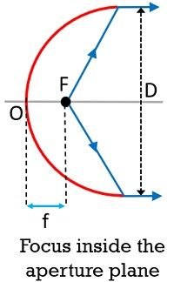
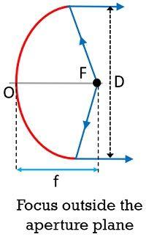
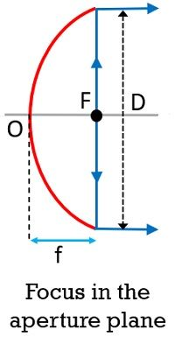

Slide 32
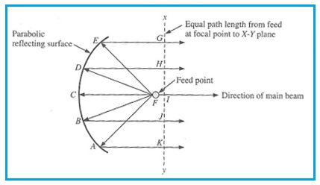

Slide 33
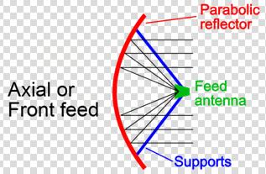

Slide 34
Parabolic reflector feed types
There are several different types of parabolic reflector feed systems that can be used. Each has its own characteristics that can be matched to the requirements of the application.
Focal feed - often also known as axial or front feed system
Cassegrain feed system
Gregorian feed system
Off Axis or offset feed

Slide 35
Focal feed system
The parabolic reflector or dish antenna consists of a radiating element which may be a simple dipole or a waveguide horn antenna. This is placed at the focal point of the parabolic reflecting surface. The energy from the radiating element is arranged so that it illuminates the reflecting surface. Once the energy is reflected it leaves the antenna system in a narrow beam. As a result considerable levels of gain can be achieved.
Achieving this is not always easy because it is dependent upon the radiator that is used. For lower frequencies a dipole element is often employed whereas at higher frequencies a circular waveguide may be used. In fact the circular waveguide provides one of the optimum sources of illumination.
The focal feed system is one of the most widely used feed system for larger parabolic reflector antennas as it is straightforward. The major disadvantage is that the feed and its supports block some of the beam, and this typically limits the aperture efficiency to only about 55 to 60%.

Slide 36
Cassegrain feed system
The Cassegrain feed system, although requiring a second reflecting surface has the advantage that the overall length of the dish antenna between the two reflectors is shorter than the length between the radiating element and the parabolic reflector. This is because there is a reflection in the focusing of the signal which shortens the physical length. This can be an advantage in some systems.
Typical efficiency levels of 65 to 70% can be achieved using this form of parabolic reflector feed system
The Cassegrain parabolic reflector antenna design and feed system gains its name because the basic concept was adapted from the Cassegrain telescope. This was reflecting telescope which was developed around 1672 and attributed to French priest Laurent Cassegrain.

Slide 37
Gregorian parabolic reflector feed
The Gregorian parabolic reflector feed technique is very similar to the Cassegrain design. The major difference is that except that the secondary reflector is concave or more correctly ellipsoidal in shape.
Typical aperture efficiency levels of over 70% can be achieved because the system is able to provide a better illumination of all of the reflector surface..

Slide 38
Off Axis or offset feed
As the name indicates this form of parabolic reflector antenna feed is offset from the centre of the actual antenna dish used.
The reflector used in this type of feed system is an asymmetrical segment of the parabolic shape normally used. In this way the focus, and the feed antenna are located to one side of the reflector surface.
The advantage of using this approach to the parabolic reflector feed system is to move the feed structure out of the beam path. In this way it does not block the beam.
This approach is widely used in home satellite television antennas, which are often relatively small and this would mean that any the feed structure including the low noise box (amplifier, etc) would otherwise block a significant percentage of the beam and thereby reduce the antenna efficiency and signal level.
The offset feed is also used in multiple reflector designs such as the Cassegrain and Gregorian because the small reflector would also suffer the same issues.

Slide 39
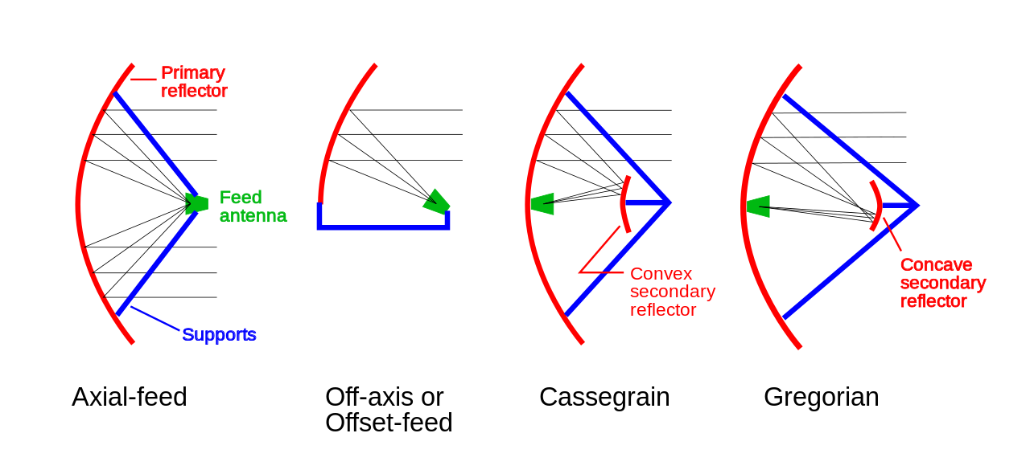

Slide 40
Advantages
The use of parabolic reflectors reduces minor lobes.
It offers high gain and directivity.
The amount of power wastage is comparatively less than other antennas.
It provides flexibility in positioning the feed element.
The use of parabolic reflector helps to provide easy beam adjustment.
Disadvantages
The size of the structure quite large.
The overall cost of the system is high.
The small element of paraboloid causes some amount of power obstruction

Slide 41
Applications of Parabolic Reflector
The high directive gain offered by these antennas makes it suitable for various applications like:
Satellite communication
TV signal broadcasting
Wireless communication
Radio astronomy
Parabolic microphones and
Lighting devices such as car headlights, etc.

